Slide 1
TABULAR DATA

Slide 2
Tabular data
A very common type of data is tabular data
the most common data format on the planet! think about Excel
by experience, many scientists think they don’t have that kind of data, but they do ! you all have tabular data, if not in the experiments (e.g. images), then in the metadata of the experiments
show example:
experiment name, researcher, date start, date end, parameter1, parameter2, participant, results_id
or it could be the same data on different days
index: day
columns: wind direction, temperature, cloud coverage
What is it? columns have different types, rows can have an index
Q: What structure can hold tabular data well?
database-like storage
it depends on the usage, most databases optimize retrieving by index (explain tree-index)
other databases are column-based, they store every column independently, operations on columns (e.g. the mean of a column) is more efficient

Slide 3

Tabular data, the most common data format on the planet!
Excel and SQL databases rule the world!
This part apply to pandas, dask, spark, SQL databases, …
They all share the same basic concepts and operations
By experience, many scientists think they don’t have that kind of data, but they do ! you all have tabular data, if not in the experiments (e.g. images), then in the metadata of the experiments
show example:
experiment name, researcher, date start, date end, parameter1, parameter2, participant, results_id
or it could be the same data on different days
index: day
columns: wind direction, temperature, cloud coverage
Ariel Fischman holds the Guinness World Record for owning the most spreadsheet software (over 500!)
https://techcommunity.microsoft.com/t5/excel-blog/guinness-world-records-the-largest-collection-of-spreadsheet/ba-p/216592

Slide 4
What is tabular data?
What is it? columns have different types, rows can have a meaningful index
Date (index) | Wind speed | Wind direction | Rain fall (mm) | Hours of sun
7.3.2024 | 7.1 | N | 0.0 | 10
8.3.2024 | 0.3 | NW | 2.1 | 2
9.3.2024 | 1.1 | SE | 0.3 | 5
Subject ID (index) | Condition ID | Presentation nr | Response time (ms) | Response
VM | 732 | 2 | 28 | LEFT
VM | 732 | 3 | 41 | RIGHT
PB | 665 | 1 | 73 | LEFT

Slide 5
Storing tabular data
Python tools
pandas: columnar, in-memory
dask: columnar, on-disk
SQL databases
optimized for retrieving rows (tree data structure for index)
transactional: groups of operations are either all executed, or none
Columnar DBs, Spark, Hadoop
optimized for operations on columns
ideal for data science tasks
operations can be automatically distributed over multiple machines

Slide 6
Common operations on tabular data
Once more, we need to avoid for loops and vectorize
Tabular data has additional needs compared to arrays. Understanding how to vectorize these operations is critical for handling them
(filtering, select operations)
Summary tables (split-apply-combine): number of sales per employee per month; employment rate per age group and state; etc
Combine information across tables (merging, anti-merging): combine employee personal data table with sales table and employee vacations table; create a new employee table without employees whose name starts with ‘P’
Window functions

Slide 7
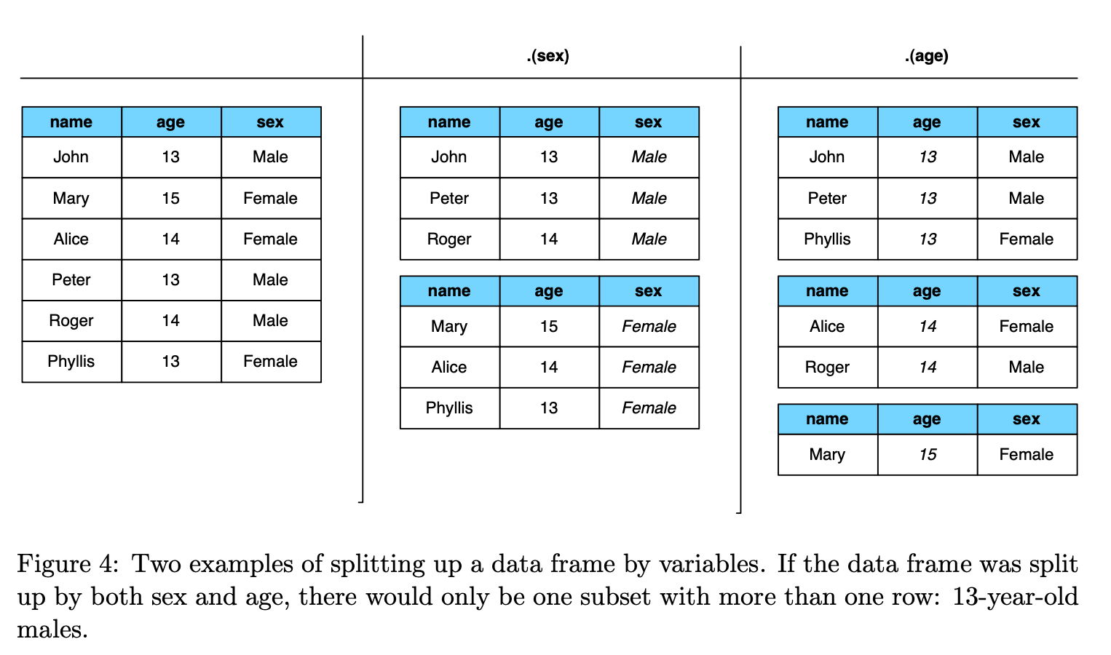
students
.groupby(‘age’)
[‘name’].nunique()
age | count
13 | 3
14 | 2
15 | 2

Slide 8
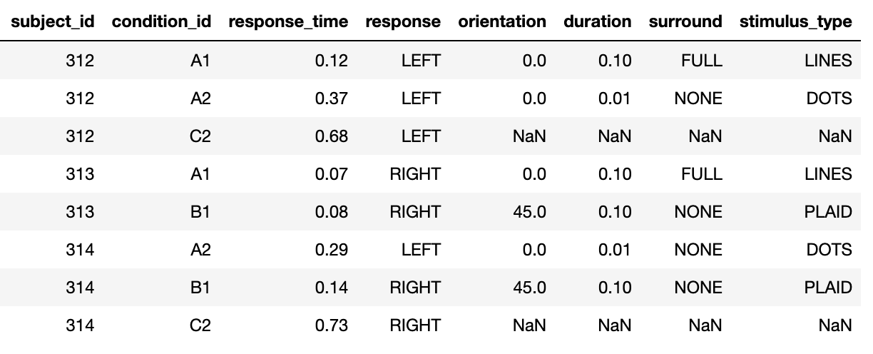
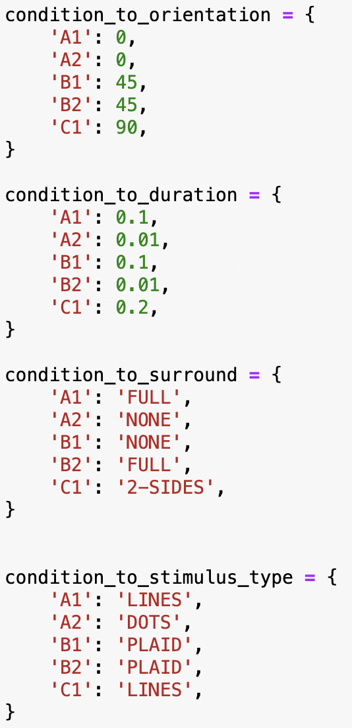
Join operations: combining informations on separate tables

Slide 9
Data organization
Do this part after showing all the pivots, melt etc.
do all exercises before with tidy data, then do the last exercise with untidy data -> why was this one so difficult??
Data organization concepts:
tidy data
normalized data (star organization)
data science friendly data (denormalized)

Slide 10
Tidy data
“Tidy datasets are all alike but every messy dataset is messy in its own way” – Hadley Wickham
Let’s talk about data organization: what does “clean” data look like?
We want data to be in a natural format, where data analysis is easy
Let’s look at what tidy data looks like, then why it’s better that way
Values are organized in variables and observations
Observations increase when new units (dates, subjects, …) are measured
Variables (or features, attributes)
increase when new types of measurements are introduced
Subject ID (index) | Condition ID | Presentation nr | Response time (ms) | Response
VM | 732 | 2 | 28 | LEFT
VM | 732 | 3 | 41 | RIGHT
PB | 665 | 1 | 73 | LEFT
Observations (or samples)

Slide 11
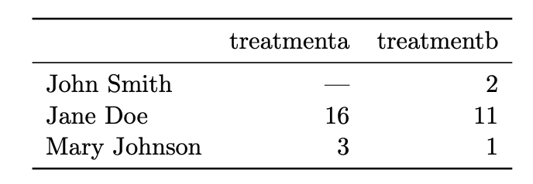
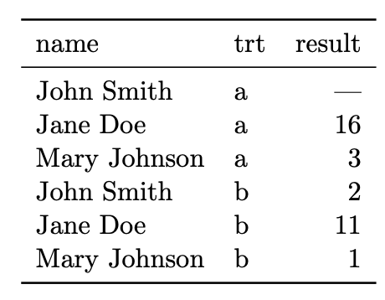
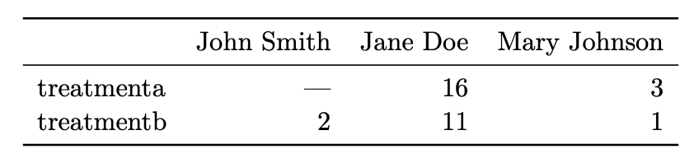
Same data, different organizations -- which one is best for data analysis?
imagine adding a new measurements, e.g. accuracy
The value of the treatment variable is in the column/row name. Imagine wanting to compute the mean over treatment type

Slide 12
Tidy data
In a given analysis, there may be multiple levels of observation. For example, in a trial of new allergy medication we might have three observational types: demographic data collected from each person (age, sex, race), medical data collected from each person on each day (number of sneezes, redness of eyes), and meterological data collected on each day (temperature, pollen count).
In tidy data:
1. Each variable forms a column. 2. Each observation forms a row. 3. Each type of observational unit forms a table

Slide 13
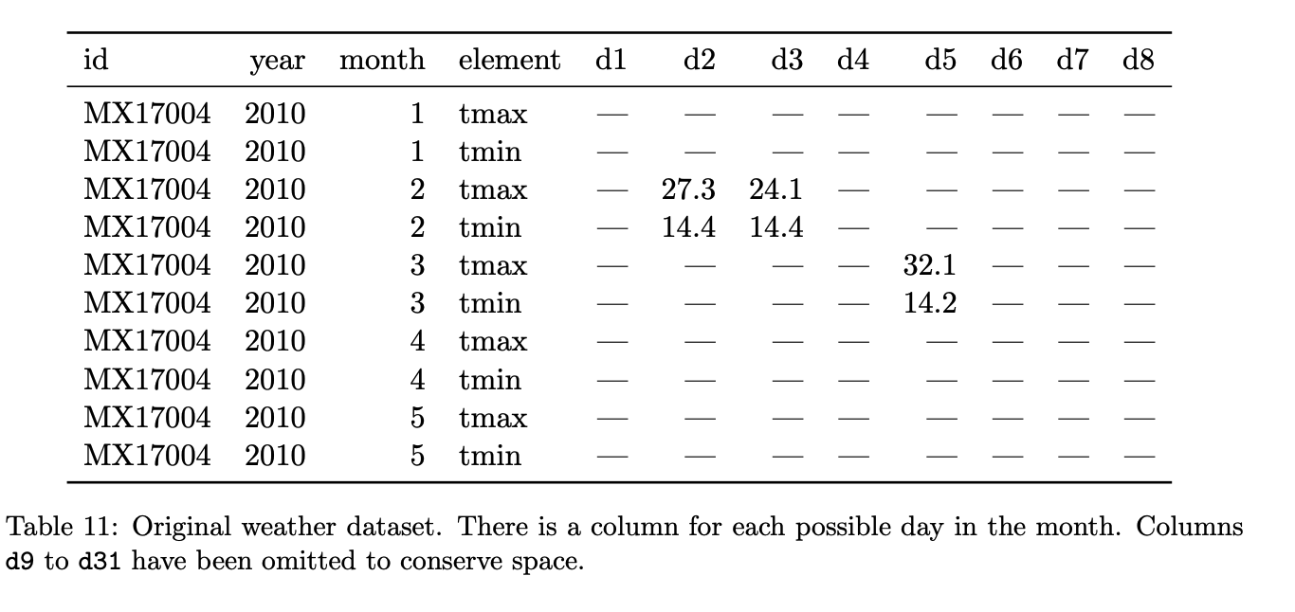
Hands-on: identify variables, observations, and values. What would a tidy version look like?
notice the structural NaNs for months with less than 31 days

Slide 14
Messy data
Column headers are values, not variable names -> as in the example above
Multiple variables are stored in one column.
Variables are stored in both rows and columns.
Multiple types of observational units are stored in the same table.
A single observational unit is stored in multiple tables
Sometimes data is split in files, and the file name is a variable! e.g. 2024-01_prices_DE.csv, 2024-01_prices_FR.csv, 2024-02_prices_DE.csv, 2024-02_prices_FR.csv, …

Slide 15
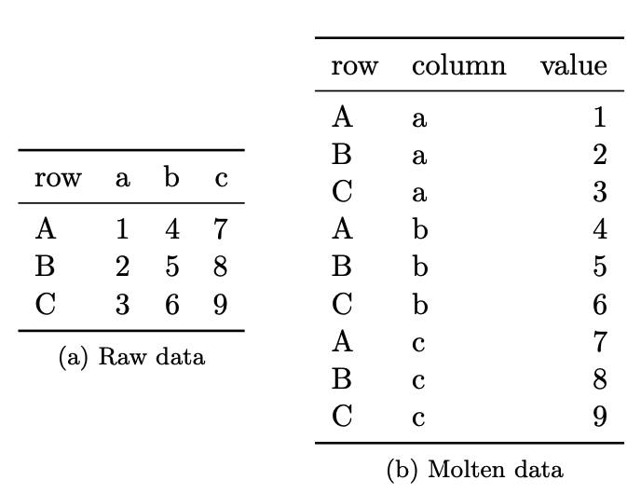
Make data tidy!
stack, unstack, melt

Slide 16
Hands-on: tidy up the data set in the previous exercise, and re-compute the summary stats
Billboard 100, max position per artist and month?
TB dataset: compute TB rate for gender

Slide 17
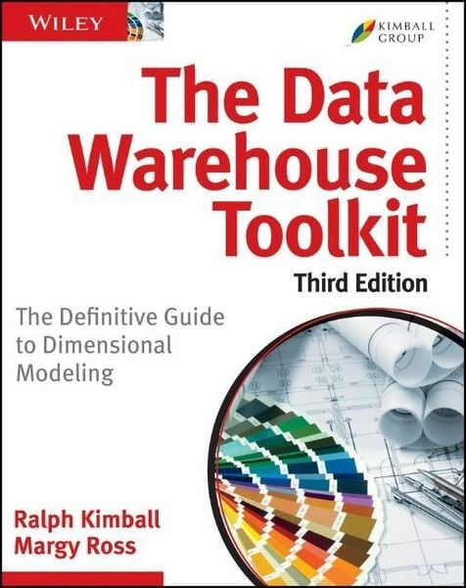
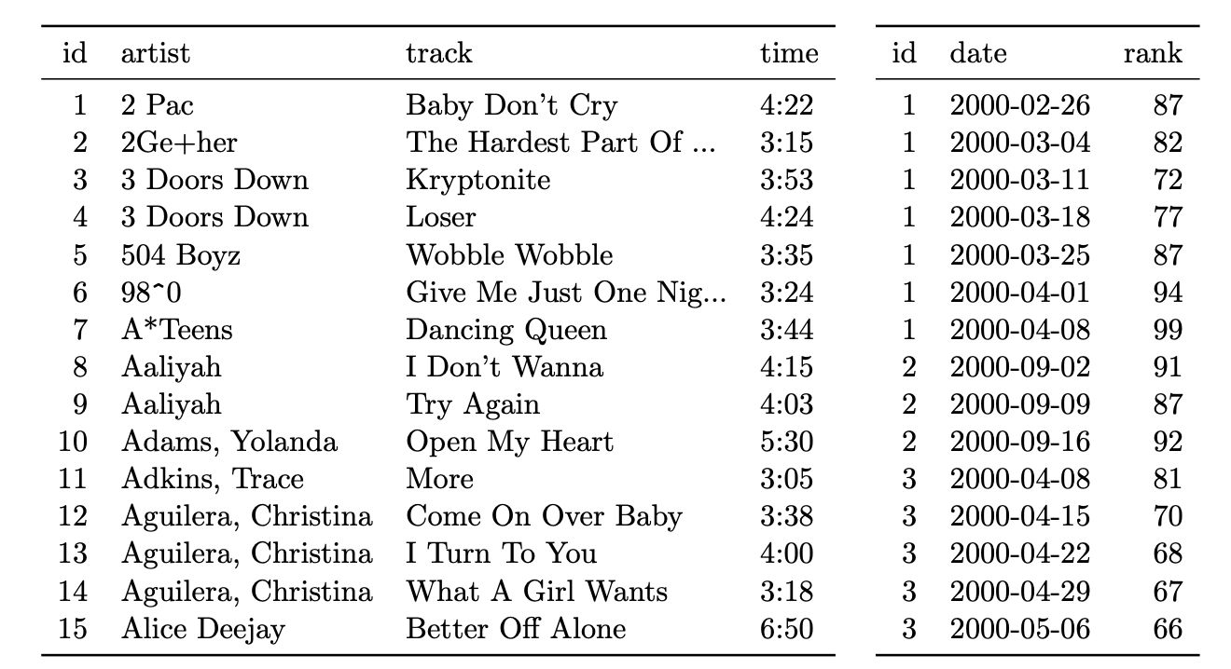
Organizing multiple tables
Dimension vs fact tables
De-normalization (but for data analys flat tables are more convienent)

Slide 18
Why is tidy data good?
One can write generic code that takes tidy data as input. For example, pd.pivot_table
Joining tidy tables is easy!
Most analyses require a simple sequence of steps:
Filter by individual variables to discard data that is not needed
Group and summarize
Re-arrange (e.g. sort)
Visualize
E.g. seaborn combine the last 3 steps to perform easy visualization with tidy data set (example?)

Slide 19
Dealing with changes in the data
Recommendations:
NEVER overwite a data file. Treat data files as immutable
Use versioning for changes in the data file, and load the latest version for new analyses, old versions to reproduce previous results
(pond is a library I’m working on to automatize this process)
Like in computer code:
Adding new columns / rows is generally ok
Deleting/changing a column is not! Code will break! Add a new column instead

Slide 20
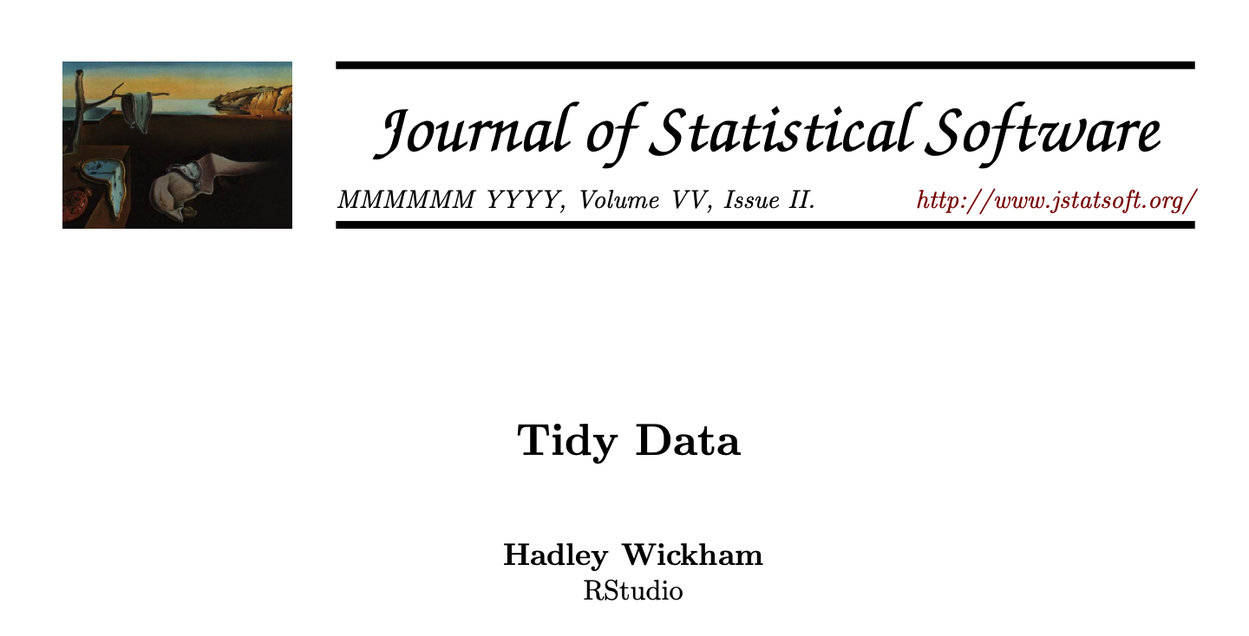

Slide 21
Thank you!

